Slide 1




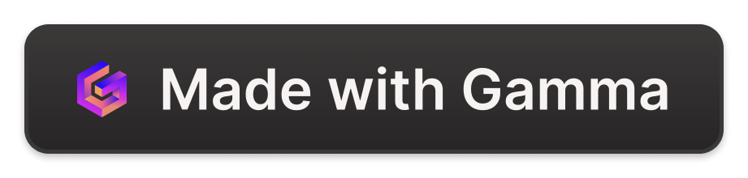
Comment Generator Tool
A Professional Overview
by Ahmad Fahad

Slide 2
Introduction to the Project
The purpose of this project is to create a tool that generates random comments for social media using Python and Flask. This is an important tool because it can help automate the creation of engaging and diverse comments for various platforms, saving time and effort for social media managers and content creators.
Purpose
Importance
To create a tool that generates random comments for social media using Python and Flask.
Helps automate the creation of engaging and diverse comments for various platforms.

Slide 3

Project Objective
The main objective of this project is to develop a Random Comment Generator Tool that can create unique, contextual, and engaging comments for social media posts. This tool will help streamline the content creation process, allowing social media managers to generate a diverse range of comments quickly and efficiently, ultimately improving the overall engagement and interaction with their audience.
1
Develop a Random Comment Generator
Create a tool that can generate unique, contextual, and engaging comments for social media posts.
2
Streamline Content Creation
Help social media managers generate a diverse range of comments quickly and efficiently.
3
Improve Audience Engagement
Ultimately, the tool will help improve the overall engagement and interaction with the audience.

Slide 4
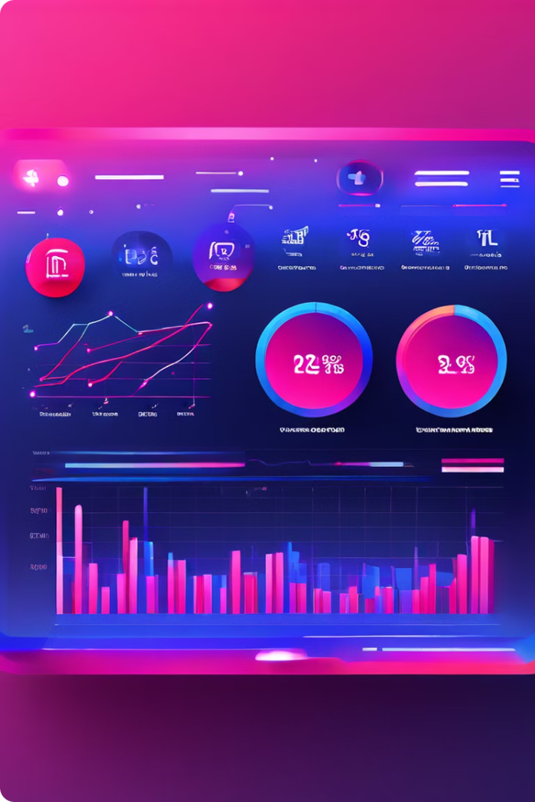
Key Features
The Random Comment Generator Tool offers several powerful features:
Keyword-based Generation: Create comments tailored to specific topics or themes.
Customizable Tone: Adjust the voice and style to match your brand.
Analytics & Tracking: Monitor performance to refine your strategy.

Slide 5

Technical Architecture
The Random Comment Generator Tool will be built using Python and the Flask web framework. Python was chosen for its versatility and powerful capabilities in data processing and text generation, while Flask provides a lightweight and flexible web application framework to build the tool's user interface and API. The tool will utilize natural language processing (NLP) techniques to analyze the content of social media posts and generate relevant, contextual comments. Additionally, the tool will leverage machine learning algorithms to continuously improve the quality and relevance of the generated comments based on user feedback and engagement metrics.
1
Python and Flask
The core of the tool will be built using Python and the Flask web framework, providing a robust and flexible foundation.
2
Natural Language Processing
NLP techniques will be used to analyze social media content and generate relevant, contextual comments.
3
Machine Learning
ML algorithms will continuously improve the quality and relevance of the generated comments based on user feedback and engagement metrics.

Slide 6

Comment Generation Logic
Tokenization of Comments
Creation of a Transition Dictionary
Generative Function
The first step is to break down existing comments into individual words, phrases, and sentence structures. This allows the tool to analyze the components and understand the relationships between them.
The final step is to implement a function that leverages the transition dictionary to generate new comments. This function takes a seed word or phrase and uses the dictionary to build a complete, contextually relevant comment.
The transition dictionary is a crucial component that maps the connections between different words and phrases. This enables the tool to seamlessly transition between them when generating new comments.

Slide 7

API Endpoint
The Random Comment Generator Tool offers a convenient API endpoint for generating contextual comments. The endpoint is located at /generate, and it can be accessed using the HTTP POST method.
To use the API, you'll need to provide a seed_word parameter, which is the starting point for the comment generation. Additionally, you can optionally include a next_words parameter to specify the desired length of the generated comment (the default is 5 words).
Once you've submitted your request, the API will return a JSON object containing the generated comment. This comment will be tailored to the provided seed word and will leverage natural language processing techniques to ensure relevance and coherence.

Slide 8

Running the Application
Launch the Flask App
1
Begin by running the Flask application using the provided command. This will quickly start the local development server and make the tool accessible for you to explore.
2
Explore the Web Interface
The intuitive web-based interface allows you to easily generate random comments directly within your browser. Interact with the user-friendly UI to see the tool in action and witness the power of the comment generation engine.
Test the API Endpoint
3
Dive deeper by testing the API functionality. Send HTTP POST requests to the /generate endpoint, providing a seed word to kickstart the comment generation process. Observe how the tool leverages natural language processing to produce contextually relevant and engaging comments.

Slide 9




User Interface
The Random Comment Generator Tool will feature a clean and intuitive user interface, designed to make it easy for social media managers to generate and manage comments for their platforms. The interface will include options for selecting the target platform, setting specific keywords or themes, and customizing the tone and style of the generated comments. Additionally, the tool will provide real-time feedback and analytics to help users track the performance and effectiveness of the generated comments.
Platform Selection
Keyword/Theme Selection
Choose the target social media platform for comment generation.
Set specific keywords or themes to guide the comment generation process.
Tone and Style Customization
Real-time Feedback and Analytics
Adjust the tone and style of the generated comments to match the brand's voice.
Track the performance and effectiveness of the generated comments.

Slide 10
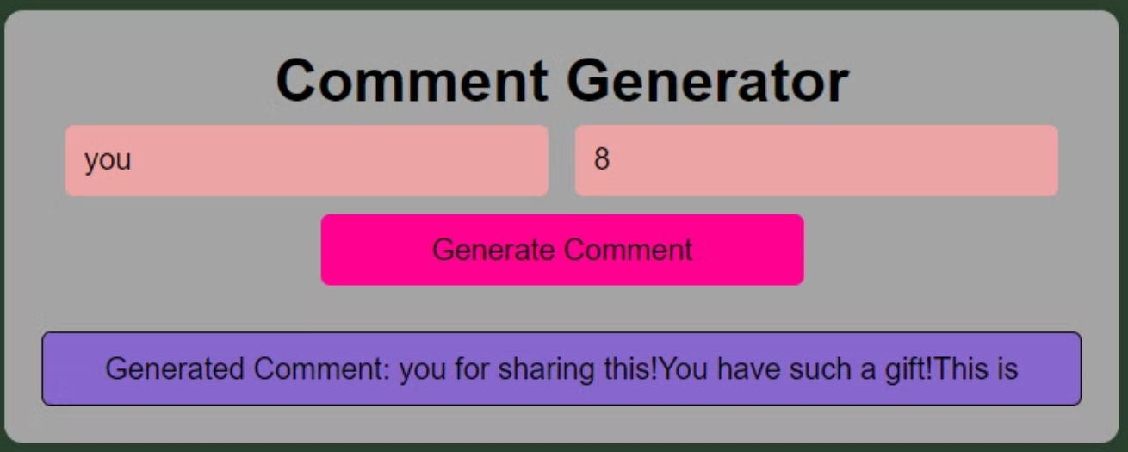
Results
Analyze the performance and effectiveness of the generated comments with the real-time feedback and analytics provided by the tool.
Customize the tone and style of the comments to align with the brand's voice and target audience.
Select the appropriate social media platform for comment generation based on the client's needs and marketing strategy.

Slide 11

Use Cases
The Random Comment Generator Tool offers versatile applications for social media marketing and engagement. It can generate comments to effectively launch new products, respond to customer inquiries, and build relationships with influencers and brand ambassadors. The tool's ability to produce unique, contextual comments also makes it valuable for running social media contests and giveaways, boosting user participation and interaction.

Slide 12

Future Enhancements
As the Random Comment Generator Tool continues to evolve, several potential enhancements and features could further improve its functionality and capabilities. These may include integrating sentiment analysis to ensure the generated comments align with the desired emotional tone, adding multilingual support to reach a global audience, and incorporating machine learning-based content generation to create even more unique and engaging comments.
Sentiment Analysis
Analyze the sentiment of generated comments to maintain the desired emotional tone.
Multilingual Support
Translate comments into multiple languages to reach a global audience.
AI-powered Content Generation
Use machine learning to create even more unique and engaging comments.

Slide 13

Conclusion
The Random Comment Generator Tool is a powerful solution that can significantly enhance social media engagement and content creation. By automating the process of generating unique, contextual, and relevant comments, this tool can save time, improve efficiency, and ultimately drive better results for social media managers and content creators. The tool's versatility, customization options, and robust technical architecture make it a valuable asset for any organization looking to optimize its social media presence and connect with its audience in a more meaningful way.

Slide 14


Thank you for Joining
You have embarked on an exciting journey of exploring the Random Comment Generator Tool.
Through dedicated practice and exploration, we can unlock new insights and abilities.
Follow me

